Slide 1
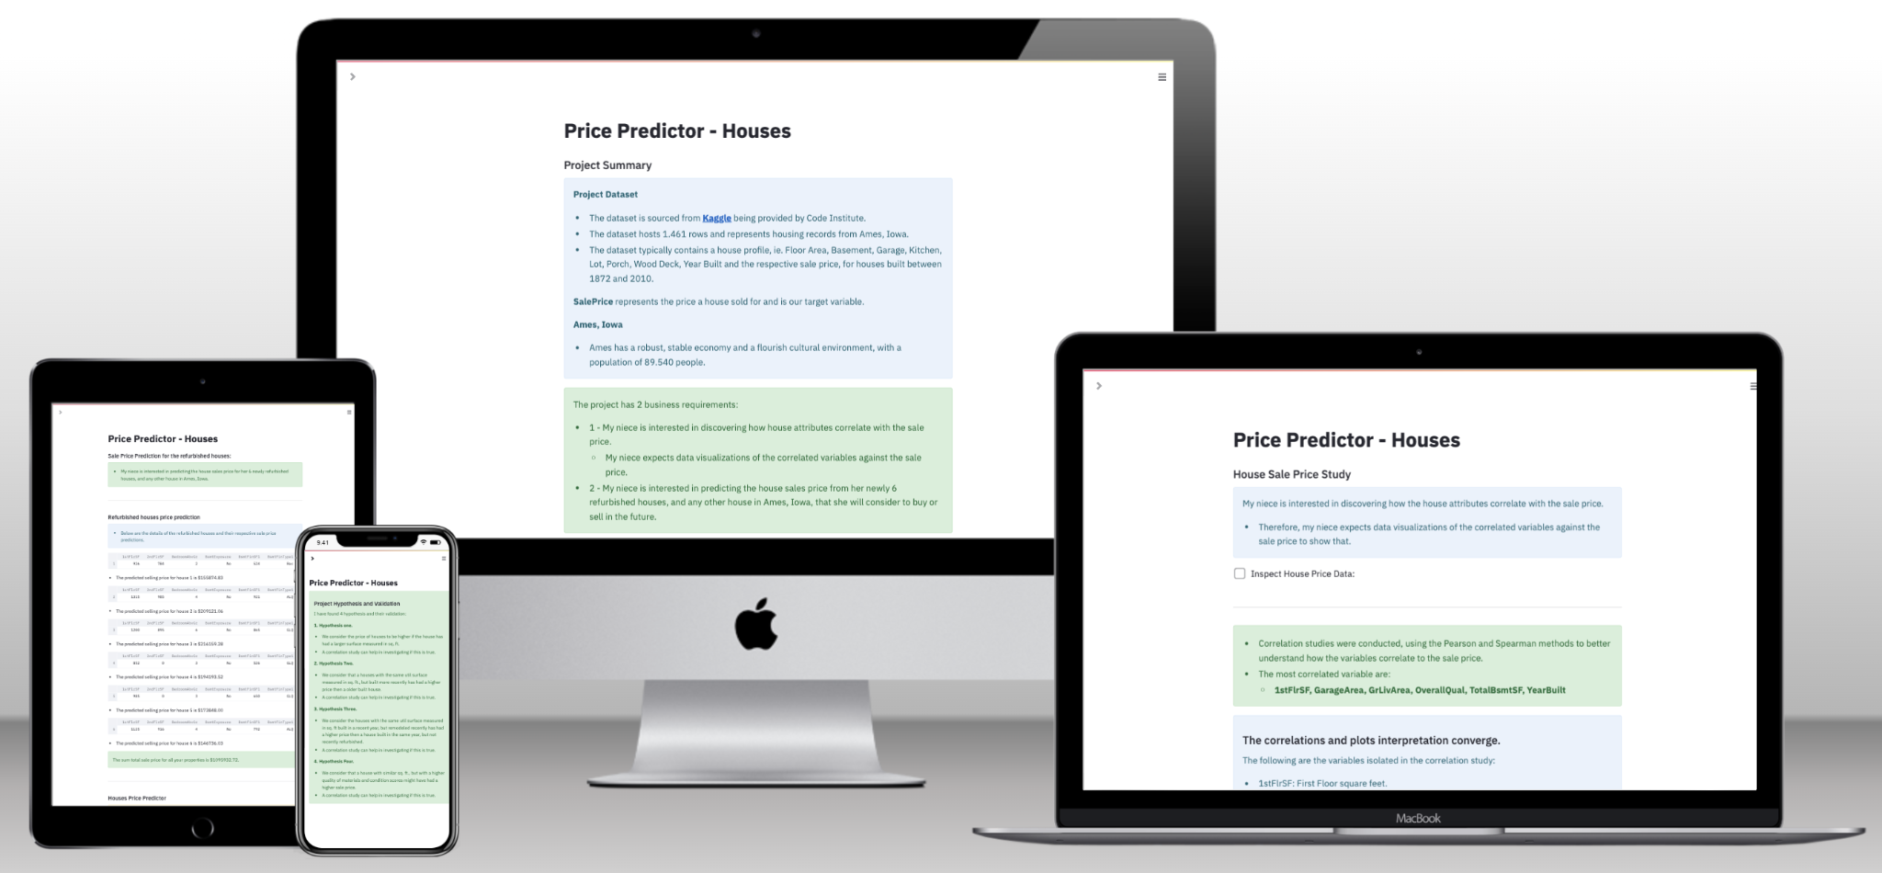

Influences on Customer Churn
Review of various available customer measures on chance of churn.
The Query Crew

Slide 2
Planning & Design
Ideation
Design
Technologies
Project Goal: Build dashboard to report on Churn in the Credit Card customers.
Use Cases: Gender biased Churn, Income biased Churn, Transaction biased Churn, Age biased Churn
Business Case: Gain understanding of Churn in order to make informed business decisions.
Target Audience: Business professionals, analysts, and decision-makers.
User Stories:
"As the Manager, I want to understand relevance of Gender on Churn.“
"As the Manager, I want to understand relevance of Income on Churn."
"As the Manager, I want to understand relevance of Transaction Volume on Churn.“
"As the Manager, I want to understand relevance of Age on Churn."
Intuitive UI: Clean layouts, easy navigation.
Hypothesis:
“Females are statistically more likely to churn than the average for the population“
“Customers with Unknown income have a greater than average chance of churn"
“The lower a customers Transaction Volume the greater the chance they will Churn.“
“Younger customers are more likely to Churn than the population on average."
Tools: Power BI, Tableau.
Wireframing: Balsamic
Project Management: GitHub Projects.
Version Control: GitHub for collaboration.
Libraries & Frameworks: Python (Pandas, NumPy), Tableau, Power BI.

Slide 3
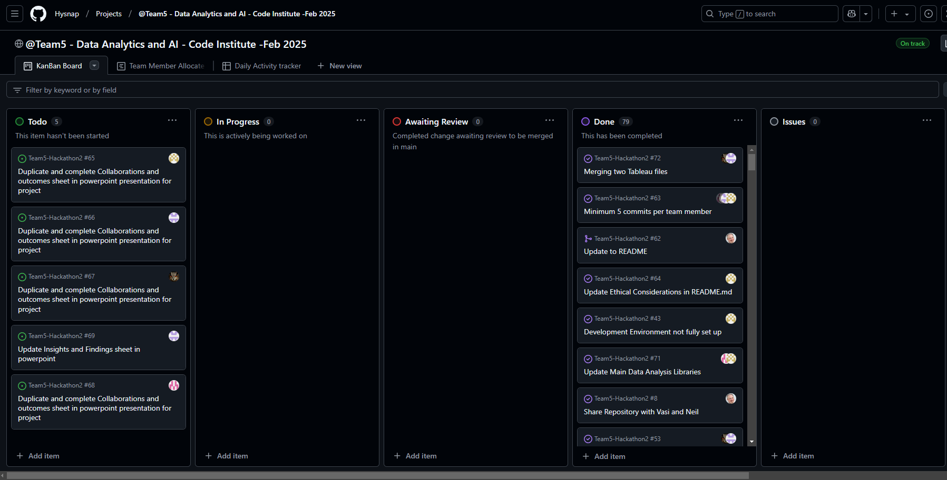
Project Board
Number of User Stories
4 Assigned Tasks
84
AGILE (MVP)
2hr 30 sprints
Project Backlog
https://github.com/users/Hysnap/projects/4

Slide 4
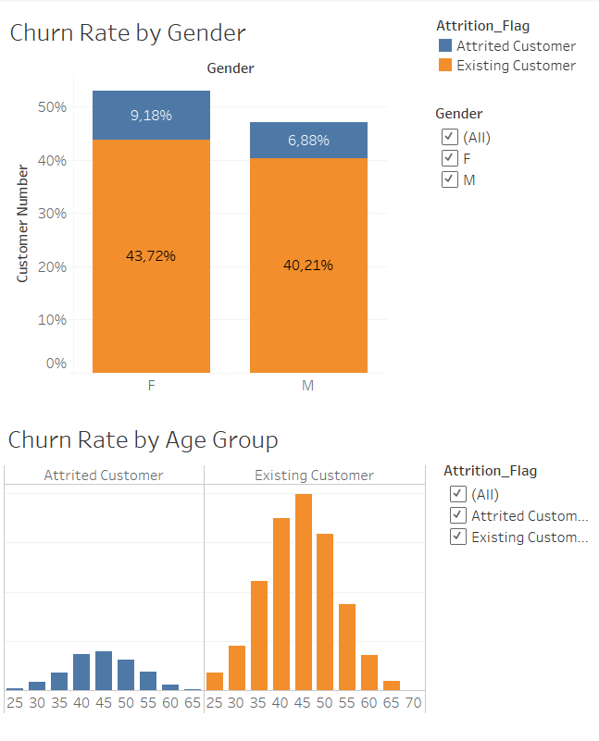
Features
Feature 1
Feature 2

Slide 5
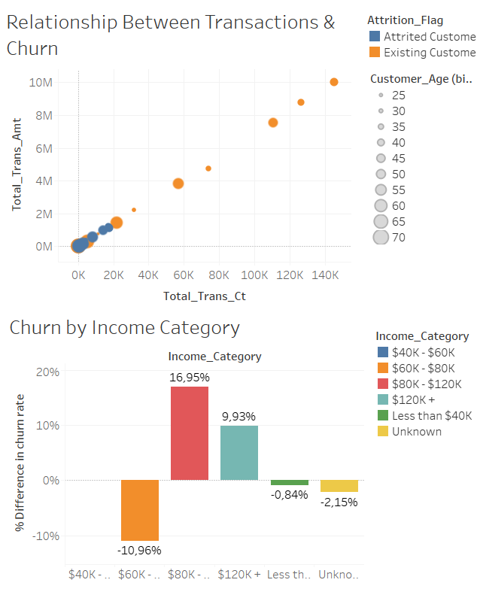
Features
Feature 3
Feature 4

Slide 6
Documentation, Testing & Version Control
GitHub Repository:
https://github.com/Hysnap/Team5-Hackathon2

Slide 7
Insights & Findings
Key Data Insights
Women and Churn:
This hypothesis was supported.
T-Test results of a T-stat of 3.777 and a P-value of 0.00016 giving a significant difference in Churn rate.
Specific Age Group Churn:
There was no strong evidence that the age of a customer or the age group they were in was an influence on Churn.
The T-Test results of T-Stat 1.899 and P-Value 0.058.
Transaction Volume Churn:
The lower the transaction volume the greater the chance of churn.
T-stat was -54.142 and P-value was 0.0000 giving a significant difference in Churn rate.
Unknown Income category Churn:
When comparing the Average Churn rate of all the income categories there was a perceived relation between increasing income and decreasing chance of churn.
The Unknown income category was not the lowest and fitted in the middle of the distribution and as such was deemed not to have an increased chance of churn.
T-tests were not undertaken for this hypothesis.
Findings & Business Impact
There are definite relationship between customers who are female and have low volumes of transactions and the chance the customer will churn.
Benefit could be acquired through enhancing the data set with further dated snapshots and then analysis to identify potential behaviour chances that precede churn of customer, which could then be tracked and targeted for retention.
Actionable Insights:
Target Women and low transaction volume customers with retention offers.

Slide 8
Collaboration & Outcomes –Ewa
Outcomes
Collaboration
Development Problems
Summary
Are you happy with the final product?
Yes
What do you hope to achieve in the next development cycle?
I would enhance the interactivity of the dashboard
What would you do differently if you could start again?
I would create the initial visualization in Tableau instead of Python
Problems that arose during development?
Technical problems with VS Code
In group conflicts and resolutions?
None
Did you find any of the behaviour related content useful? Teamwork, problem solving etc?
It was helpful to observe how to approach and handle technical issues in a calm manner
Interactivity
My limited knowledge of Tableau slowed down the development process
Overall group dynamic
Satisfactory
Overall satisfaction
Satisfactory
What we learned
More about Github, deeper understanding of Tableau and the support that ChatGpt in.
Our experiences
Satisfactory

Slide 9
Collaboration & Outcomes - Paul
Outcomes
Collaboration
Development Problems
Summary
Problems that arose during development?
Multiple issues with commits to Github
Difficulties with merging Tableau Files
In group conflicts and resolutions?
None- the team worked well together
Did you find any of the behaviour related content useful? Teamwork, problem solving etc?
The use of agile methodology to guide development.
The use of huddles and team development to solve problems.
Interactivity
Need to better understand Interactivity in Tableau to increase
Overall group dynamic
Worked well together
Overall satisfaction
Generally happy with what was achieved although, slightly more on point project management may have enabled us to progress further.
What we learned
We learned a lot more about GitHub and the capabilities of Tableau, along with how various graphs show information
Our experiences.
It was an engaging and rewarding if sometime frustrating
Are you happy with the final product?
Yes
What you hope to achieve in the next development cycle?
Look to increase functionality hat do and also look at introducing tracking of customer behaviour through multiple data slices.
What would you do differently if you could start again?
Introduce the habit of commiting all changes at each of our 2hr 30 standups, also introduce more specific tasks per sprint.

Slide 10
Collaboration & Outcomes-Selda Sen
Outcomes
Development Problems
Summary
Are you happy with the final product?
Yes
What do you hope to achieve in the next development cycle?
I hope to be able to do this project alone, which we did as a group.
What would you do differently if you could start again?
I wouldn't change anything about the process.
Overall group dynamic
It was excellent
Overall satisfaction
I am satisfied
What we learned
I was able to think more deeply about how data visuals help us. I learned how to connect VsCode and GitHub. I learned how to do things as a team member in a project.
Our experiences.
I realized once again that numbers in a data containing about ten thousand lines do not have a simple meaning. It is easy to find the highest or lowest, but it is quite complicated to understand the relationships of other values, to produce a theory and try to test whether it is true or not. This really requires knowledge and experience.
Problems that arose during development?
While using vscode, we realized that I was using Ewa's space, then we opened my own space. Closing, deleting and re-uploading the file took extra time.
In group conflicts and resolutions?We were a very good group. We did not have any disagreements.
Did you find any of the behaviour related content useful? Teamwork, problem solving etc?Everyone was very helpful. Paul organized us very well by distributing the tasks very well. He also helped us a lot wherever we needed help, using his previous experiences. We did data visualization with Ewa. We exchanged ideas and prepared together. We completed each other in the areas where we were lacking.
Collaboration

Slide 11
Collaboration & Outcomes - Saad
Outcomes
Collaboration
Development Problems
Summary
Are you happy with the final product?
Yes, definitely, I am happy with what we all worked together to approve.
What do you hope to achieve in the next development cycle?
Further analysis tied to wider population data.
What would you do differently if you could start again?
Nothing, I only regret having technical issues which made me lose time, not something I would have been able to change.
Problems that arose during development?
Some issues with VS Code and Github, but manages to sort that out with the help of other team members.
In group conflicts and resolutions?
None that I can think of.
Did you find any of the behaviour related content useful? Teamwork, problem solving etc?
Teamwork and problem solving definitely, they helped.
Interactivity
No issues on this point as far as I was am aware.
Overall group dynamic
It was good, we pulled together, had frequent group calls, kept up on the Slack, and helped each other.
Overall satisfaction
I am mostly satisfied with the work I did, however I wish I could’ve spent more time doing additional analysis but experienced technical and teething problems.
What we learned
We tested our hypotheses, learned the utility of encoding categorical variables into ints or floats to aid data analysis, and how to effectively work together as a team.
Our experiences.
I experienced some difficulties but am overall happy with my experience. The team members were helpful and co-operative, it helped prepare me for a group work scenario that I may encounter in the workshop.

Slide 12
Q&A
Notes:
Quick q&a 1 question each from the judges and any questions from the group.

